Slide 1
CAPSTONE PROJECT
by
Sarita Charde

Slide 2
Agenda
Define
Design
Deliver
Summarize
Next stage

Slide 3
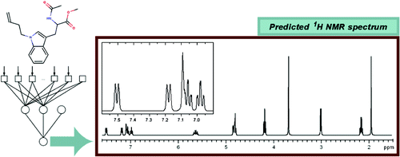
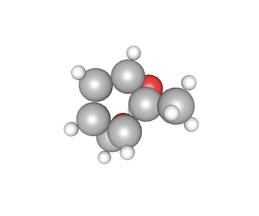
Predicting molecular properties
.

Slide 4
define

Slide 5
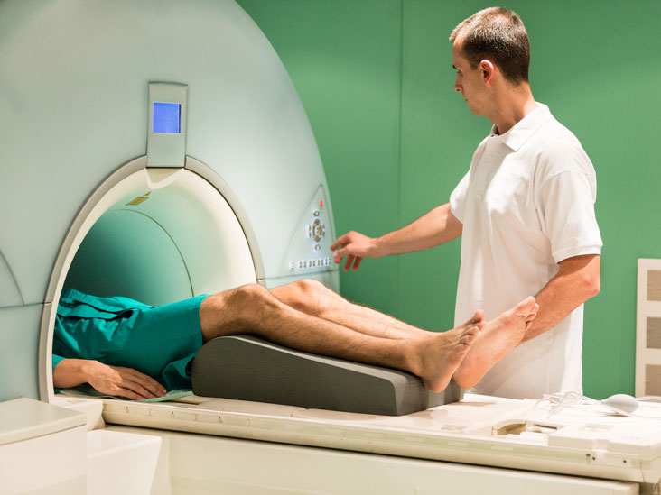
Scalar Coupling Constant
DFT
Quantum Mechanics
Machine/Deep learning
Slow and less accurate
Reliable, Costly and slow
Reliable, Fast and cheaper
Designing molecules to carry out specific cellular tasks
Designing better drug molecules to fight diseases
Health care, Pharmaceuticals and Materials Science

Slide 6
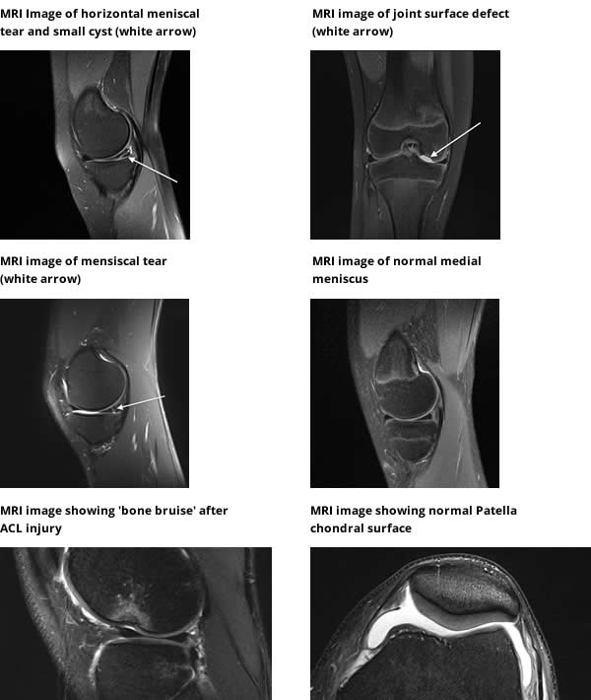
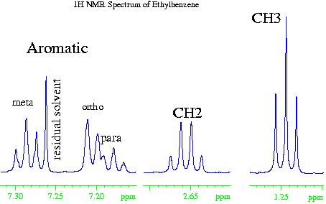
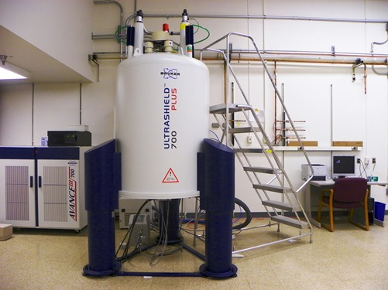
The Business Question Can data science make big predictions at the molecular level?
MRI
NMR

Slide 7
The value Proposal $$$
Quantum Mechanics Approach
Resources
Laboratory
Operators
Training
Maintenance
Experiment cost
Time
Data Science
Already generated data
&
Infrastructure

Slide 8
Dataset
This dataset is part of the CHAMPS (chemistry and mathematics in phase space) kaggle competition.
Train dataset contained 4,658,147 scalar coupling observations of 85,003 unique molecules
Test dataset contained 2,505,542 scalar coupling observations of 45,772 unique molecules.
Molecules contained only the atoms: carbon (c), hydrogen (h), nitrogen (n), fluorine (f), and oxygen (o).

Slide 9
The Data question
Can we develop an algorithm that can predict the magnetic interaction between two atoms in a molecule (i.e., The scalar coupling constant)?
Can we determine the most influencing features affecting the scalar coupling constant?

Slide 10
Design
The Pipeline and Approach

Slide 11

$
$
PHARMACEUTICAL
ENVIRONMENT
MATERIALS SCIENCE
Designing molecules for specific cellular tasks, or designing better drug molecules
CAN WE REPLACE COSTLY AND SLOW METHODS?
A fast and reliable method to predict these interactions
PREDICT MOLECULAR PROPERTIES?
Data Science
CHAMPS Kaggle
SOLUTION
WRANGLE & CLEAN
EDA
E
DATA PROCESSING & FEATURE SELECTION
MODEL
APPLY & VALIDATE
COMMUNICATE & IMPLEMENT

Slide 12
Deliver
Load data
Wrangle
Clean
EDA
Pre-processing
Creating new features
Splitting the data into 8 coupling types

Slide 13
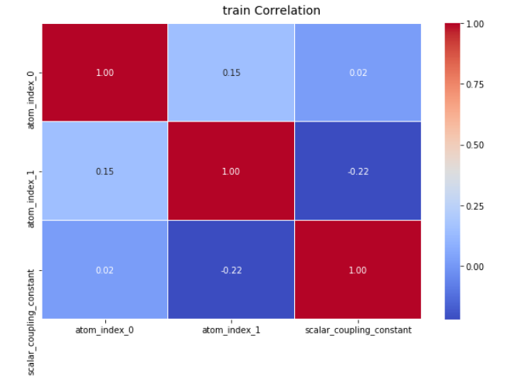
What story the Data tell?

Slide 14
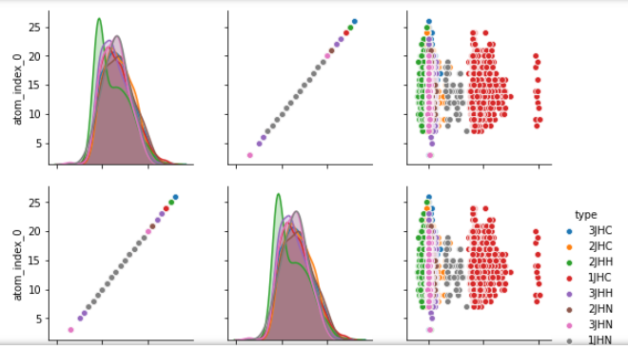
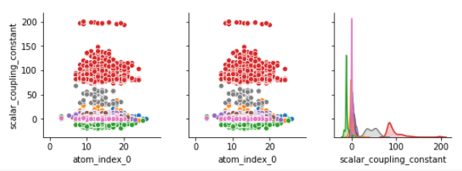

Slide 15
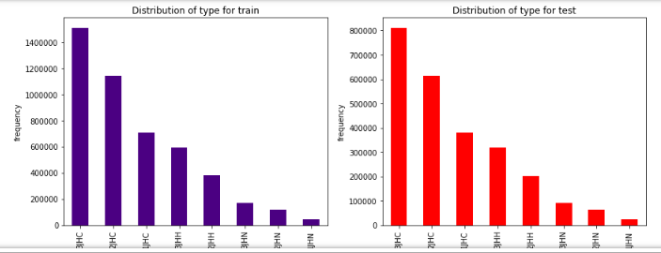
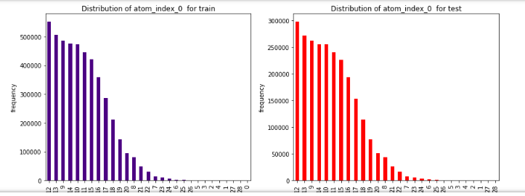
Pattern of data

Slide 16
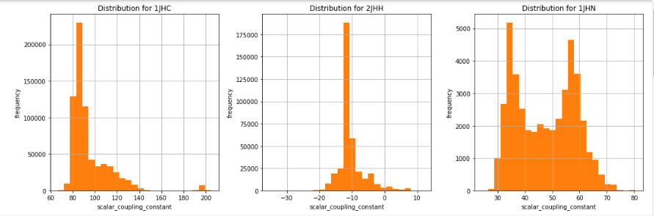
Grouping the data

Slide 17
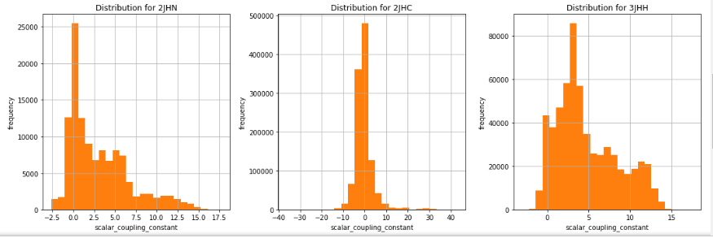

Slide 18
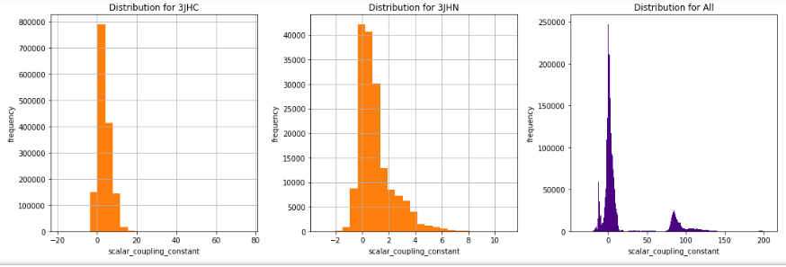

Slide 19
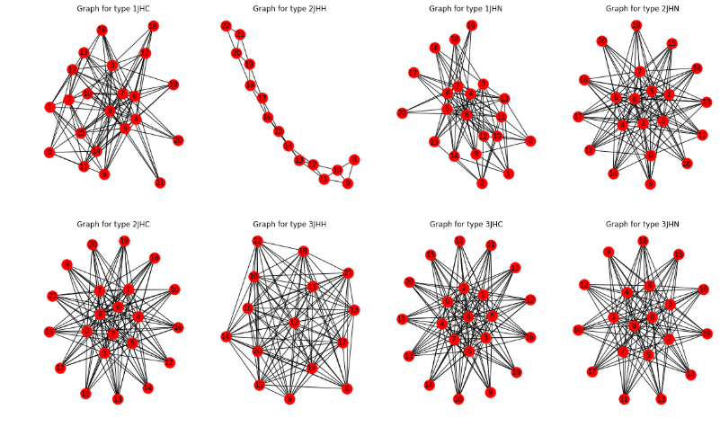

Slide 20
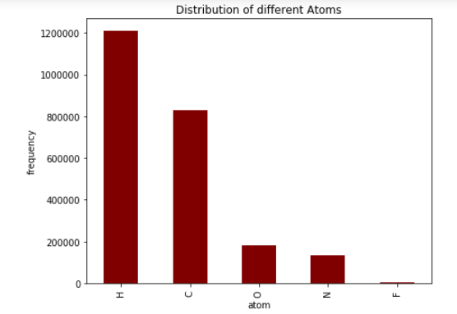
Different atoms in Data

Slide 21
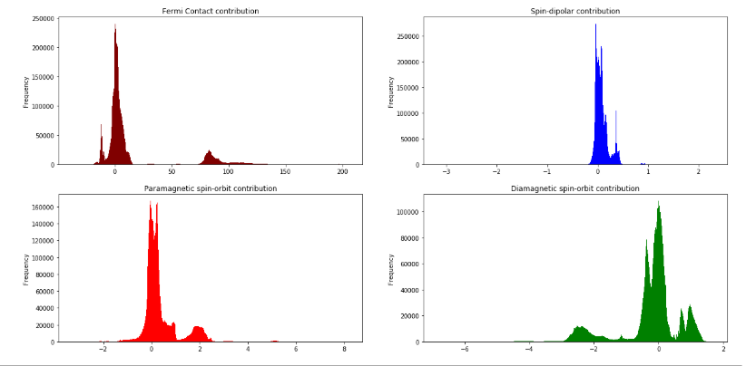
SCcontributions

Slide 22
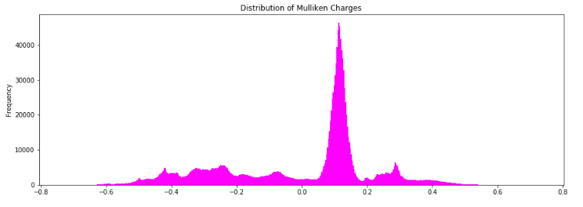
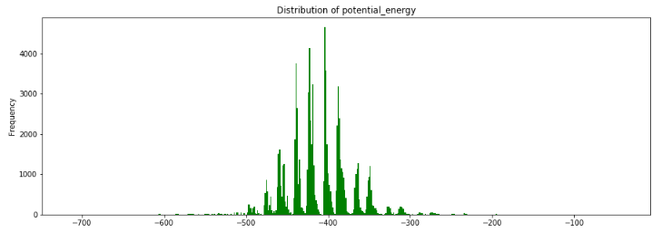
Mulliken & potential energy

Slide 23
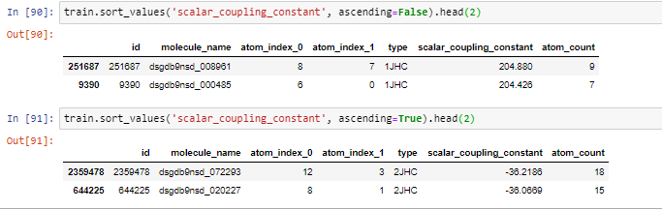
Value Range of Target

Slide 24
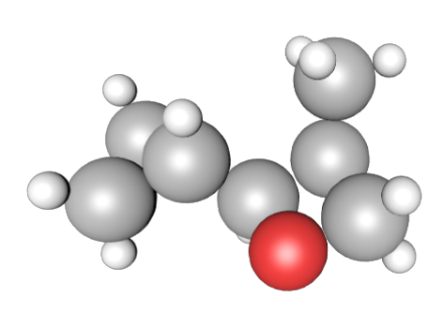
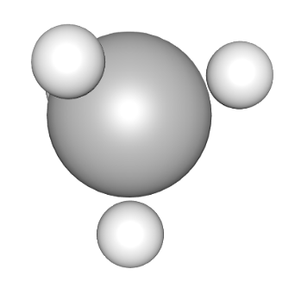
3D Structures

Slide 25
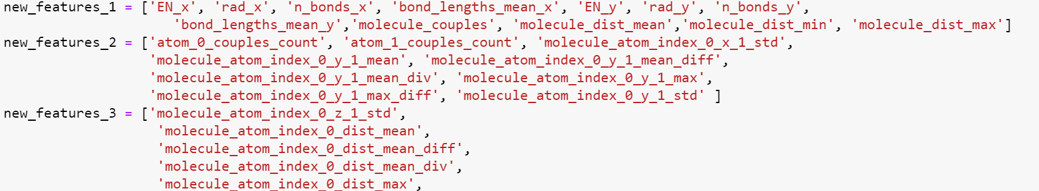
Created New features
Using the additional files
Created properties that influences properties of molecules

Slide 26
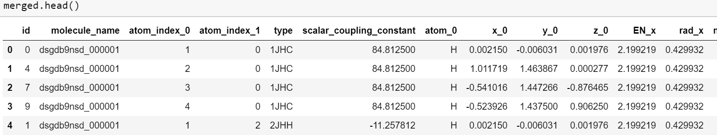
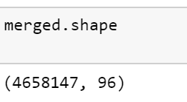
Merging the files
Merged the new file with the training data set
New dataset has new features

Slide 27
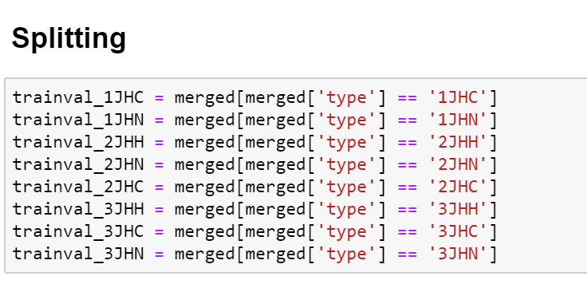
Split the data based on Coupling type

Slide 28
Summarise
Train and test data are available with similar patterns
Data is huge but number of features are less
Grouping by coupling type makes analysis easier
Structure file can be used to get 3D atomic structure using 'ase' python package
Extra files do not have corresponding test data available
Pre-processing and feature Engineering
Data split based on 8 coupling types

Slide 29
Next Steps
Design and compare the Model using
LightGBM
XGBoost
AdaBoost
Distributed random Forest
Deep Learning

Slide 30
Challenges
Huge amount of data
Number of models

Slide 31
References
Kaggle competition
Https://www.kaggle.com/c/champs-scalar-coupling/kernels

Slide 32
Thank you

